Slide 1
Raymond Chandler
The Big Sleep, 1939

Slide 2
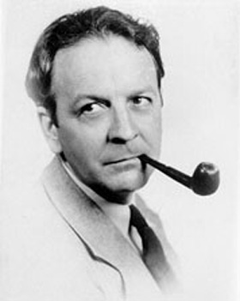
Raymond Chandler
Screen writer & author
Philip Marlowe
Hard-Boiled crime fiction
Born in Chicago → London
Back in the US in 1912
Canadian Army in WW I
At 45, full-time writer
Black Mask, Dec. 1933

Slide 3

Pulp Fiction
Inexpensive fiction magazines
From 1896 – 1950s
128 pages, cheap paper
Cheap wood pulp paper
Contrast to “glossies” / “slicks”
10 cents per magazine
Lurid stories
Sensational cover art
The Phantom Detective, 1936

Slide 4
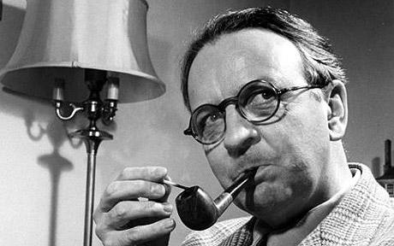
Raymond Chandler
First novel 1939
Wife died 1954
Clinical depression
Alcoholism
Attempted suicide
Traveled to Capri to interview ‘Lucky’ Luciano
Died 1959, pneumonia / alcohol

Slide 5

Philip Marlowe
33 in The Big Sleep
Tough, wisecracking
Hard drinker – whisky
Contemplative
Enjoys chess & poetry
Morally upright / Ethical
2 yrs of college
Investigator
DA’s office – fired
6 feet, 190 pounds
Smokes
Carries a gun

Slide 6
Criticism
Heavily criticized at time of writing
“rambling at best and incoherent at worst”
Blacks, females, homosexuals
Pulp fiction writer
However – all but one of his novels have been cinematically adapted
8 Philip Marlowe Novels

Slide 7
The Big Sleep
Introduction
Characters
male - female
Analogies / Metaphors
Style - Dialogue
Interaction
Plot

Slide 8
Michel Foucault – ”Discipline & Punish”
1975
Panopticism
Citizens of Western democracies act as their own jail keepers
Internalize social control
Power produces knowledge

Slide 9
Panopticism
Review of the measures taken when a plague appeared in a town:
permanent registration, segmented, immobile, frozen space
Purification by fire 5-6 days after beg. of quarantine
Discipline responds to confusion (disease) and evil (prohibitions overcome) – power in analysis and order
Utopia of perfectly governed city: ”an extensive power that bears in a distinct way over all individual bodies”

Slide 10
The Panopticon
The architectural figure of the mechanisms of power towards the individual: supervising & correcting, disciplining
Spatial unities: see constantly, recognize immediately – visibility is a trap
Inmates: objects of information, not subjects in communication
Crowd → collection of separated individualities
”to induce in the inmate a state of conscious and permanent visibility that assures the automatic functioning of power.”
Inmates are caught up in a power situation of which they are themselves the bearers.

Slide 11
Power
Visible and unverifiable
Automatized and dis-individualized
No matter who exercises it
No matter what motive lies behind
Homogeneous effects
”He who is subjected to a field of visibility, and who knows it, assumes responsibility for the constraints of power.”
”he becomes the principle of his own subjection.”

Slide 12
Aim / Goal
Strengthen the social forces
Increase production
Spread education
Raise level of public morality
Increase and multiply
Provides the formula for a society penetrated with disciplinary mechanisms

Slide 13
The Police
Minute details
Co-extensive with the entire social body
The infinitely small of political power
Permanent, exhaustive, omnipresent surveillance
Making all visible – remaining invisible
Confiscating disciplinary functions in society
Discipline is a type of power, a modality for its exercise
Our society is one of surveillance

Slide 14
Relationship
How does this relate to us,
- the societies we read about,
- and the power structures in the books

