Slide 1

Crime Fiction
in
Scandinavia

Slide 2
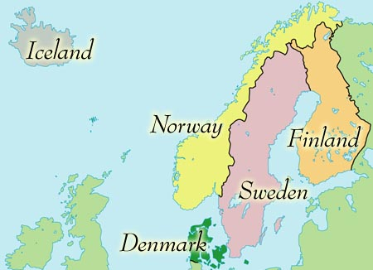
Scandinavia

Slide 3



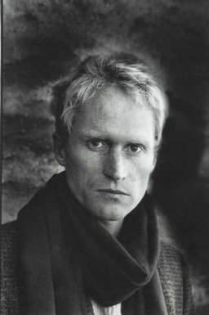

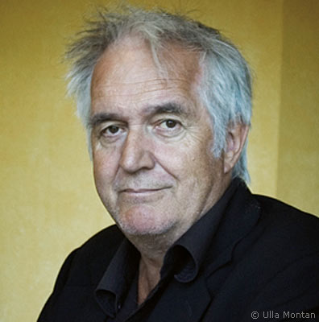

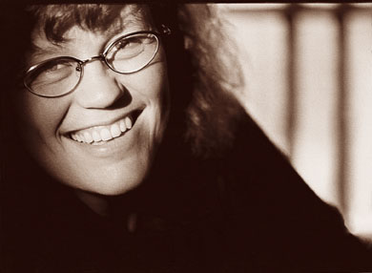
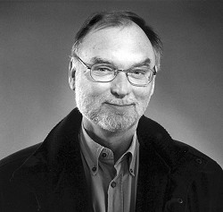


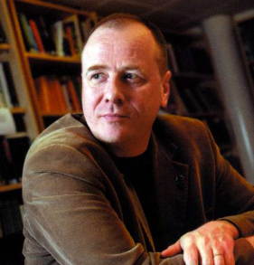
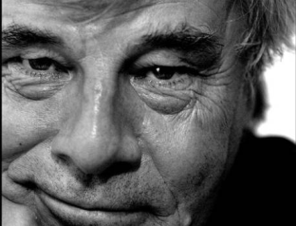
Liza Marklund
Henning Mankell
Stieg Larsson
Jan Guillou
Camilla Läckberg
Håkon Nesser
Anne Holt
Karin Fossum
Sara Blædel
Elsebeth Egholm
Leif Davidsen
Arnaldur Indridason
Peter Høeg

Slide 4
Homicide in Scandinavia and the US pr. 100.000 population
DEN FIN NOR SWE US
1985 1.3 2.4 0.9 1.5 8.0
1986 1.0 2.9 0.9 1.8 8.5
1987 0.9 2.4 0.9 1.6 8.3
1988 1.0 2.4 1.0 1.7 8.4
1989 1.1 2.8 1.5 1.8 8.7
1990 1.1 2.9 1.0 1.4 9.4
1991 1.7 3.0 0.9 1.6 9.8
1992 1.2 3.1 1.2 1.6 9.3
1993 1.4 2.5 1.1 1.6 9.5
1994 1.5 2.9 1.1 1.5 9.0
1995 1.1 2.9 0.7 1.2 8.2
1996 1.3 3.0 0.7 1.5 7.4
1997 1.7 2.7 0.6 1.3 6.8
1998 0.9 2.2 0.6 1.4 6.3
1999 1.0 2.7 0.8 1.5 5.7
2000 1.1 2.8 0.8 1.2 5.5

Slide 5
Scandinavia in comparison
Global Peace Index, 2008
Denmark # 2
Norway: # 2
Iceland: # 4
Sweden: # 6
Finland: # 9
The UK:# 35
The Netherlands: # 22
Germany: # 16
United States: # 83

Slide 6
Incarceration rates per 100,000
Denmark: 66 5.5 mill
Finland: 70 5.3 mill
Iceland: 37 316,960
Sweden: 73 9.2 mill
Norway: 59 4.8 mill

Slide 7
Incarceration rates in comparison (per 100,000)
Scandinavia
Others
Denmark: 66
Finland: 70
Iceland: 37
Sweden: 73
Norway: 59
The UK: 141
The Netherlands: 100
Germany 98
United States: 702 (Texas: 1035)

Slide 8
Monetary comparison
GDP PPP | 2008
USA | 14,264,600
Germany | 2,910,490
United Kingdom | 2,230,549
Netherlands | 675,375
Sweden | 341,869
Switzerland | 312,753
Norway | 256,523
Denmark | 204,060
Israel | 200,630
Finland | 190,862
Luxembourg | 40,025
Iceland | 12,664

Slide 9

Crime Fiction: A History

Slide 10
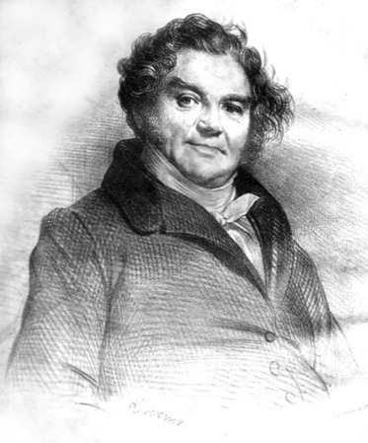
History
First efficient police force founded in France, 1791
Vidocq becomes chief of police, 1809
Vidocq publishes his Mémoires, 1828
Metropolitan Police founded, 1828
Boston Police Dept. 1838
New York City Police Dept. 1845

Slide 11
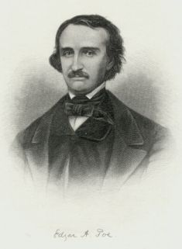
Edgar Allan Poe 1809-49
Five locked-room mysteries
Introduced many significant principles
“Murders in Rue Morgue”, 1841
“The Mystery of Marie Roget”, 1842-43
“The Purloined Letter”, 1845
Reasoning - the last possibility
First great detective:
C. Auguste Dupin

Slide 12
The “Biographies”
Yellowbacks
Wilkie Collins, The Woman in White, 1856
Victor Hugo, Les Miserables, 1862
Wilkie Collins, The Moonstone, 1868
Charles Dickens, The Mystery of Edwin Drood, 1870

Slide 13
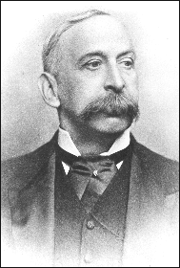
History
Detective police established in London, 1842
‘Day and night” police established in New York, 1843
Plain-clothes CID established
at New Scotland Yard, 1878
Charles Vincent, director of CID

Slide 14
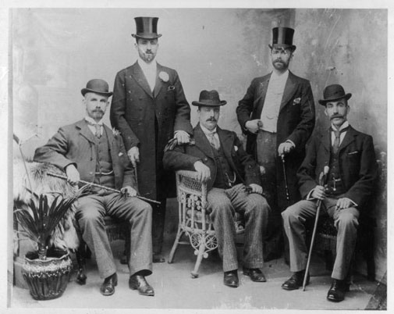
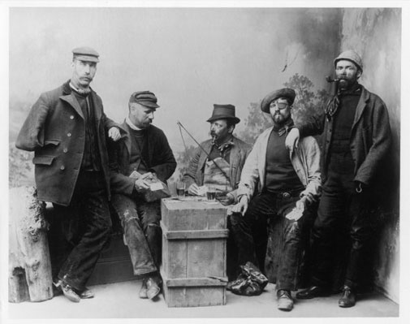
Criminal Investigations Department
CID officers cunningly disguised as dockers during an investigation into drug smugglers at Limehouse Docks C. 1911

Slide 15
“The Murders in the Rue Morgue”, 1841
What is the purpose of the long introduction?
How would you characterize Poe’s writing style?
Describe Auguste Dupin- what kind of a person is he?
Describe the narrator
What are the characteristics of the mystery?
What is Dupin’s method of solving the mystery?
Which of the elements do you recognize as a pattern for later authors?

