Slide 1
Summing up
Science Fiction in Scandinavia

Slide 2
Questions to ponder:
What do you think characterizes the science fiction we have read?
Do you find any particular “Scandinavian ambiance” in the Scandinavian texts?
What are the most interesting aspects of our readings, and what characterizes them?
Is Science Fiction “real” literature?
Is the genre of science fiction a valid tool to discuss important matters of philosophy, sociology, ethics, etc.?

Slide 3
St. Kilda, Scotland, 41 miles west of The Outer Hebrides

Slide 4
Norse Occupation – The Past
The Earth-House
Incised cross on a stone
re-used in house 16

Slide 5
The Population
Distant landlord
Small settlement
Factor
Rent paid in kind
Evacuation in 1930

Slide 6
Communal Living
Land divided according to run-rig system
1830’s: each tenant his own strip of land
Built a house
Plucking sheep in 1927

Slide 7
Birds
Seabird breeding ground
Gannets
Fulmars
Puffins
Food, feathers, oil
Consumption and rent
Caught by hand or with a snare

Slide 8
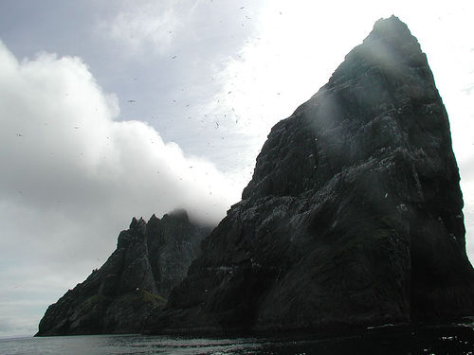
Communications
No roads, no wheels
Produce carried on people’s backs
Small open boats
Landing on the rocks
Jetty built in 1901

Slide 9
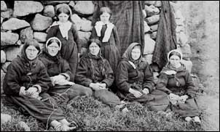
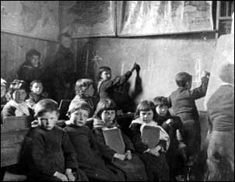
Religion and education
18th cent. Ministers
School from 1884
Hebridean stock
Spoke Gaelic
Free Church of Scotland
Women, 1886

Slide 10
The Village, on main island, Hirta

Slide 11
The Village
Watercolor, 1831
Same view today

Slide 12
The Village
1886
Mrs. Gillies and her house

Slide 13
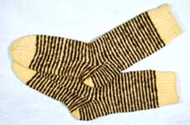
The Final Years
Tourists
Fishing Fleet

Slide 14
The Evacuation
1930
Mailboat, 1897

Slide 15
Collective Society
Seabirds
Government
Provider
Isolation
Disease
Decisions
Education
Marriage and children
Gender roles
Lover’s Stone

Slide 16
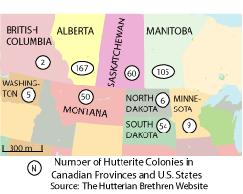
The Hutterites
1874 to the US
1918 to Canada
Anabaptist
Jacob Hutter, 1529
Peter Riedeman:
Adult baptism of believers
Community of goods
Non resistance
Separation of church and state

Slide 17
Education
Kindergarten, 2-2½ years
Grade school
Diplomas
University
Apprenticeships
German, English
The Bible

Slide 18
Dress

Slide 19
Ownership
Communally owned goods
Some personal belongings
Everything based on need
Responsibility
Potato Harvest

Slide 20
Women’s roles
Mothers – average of 10 children per household
Housewives
Cooks
Gardeners
Teachers
Seamstresses - crafts
Secretaries
No decision making
No driving
Closed off from the consumer society

Slide 21
Relationships
Purity
Led together by God
Dating ok
Impurity is severely dealt with
Choral singing
No TV etc.

Slide 22
Structure
Hierarchy
Minister
Advisory board
Colony manager
Farm manager
Witness brothers
all male, baptized members vote for the advisory board
Language: no thank you’s, please, or titles

Slide 23
Summing UP
Roles of men, women, and children, family
Education
Ethics and morals
War and enemies
Politics
The urge to survive
Language
Power
Identity
Classes / privileges
Love / Sexuality
Choice / Existence
freedom
Criticism of existing society
Portraying the ideal society
What if? / Speculative fiction
Fantasy / Philosophizing
The good life / quality
Important aspects?

