Slide 1
Technology and Warfare

Slide 2
Dystopia
Society unworthy of humans
Totalitarian state (1984, Kallocain)
Developmental derailment (Fahrenheit 451)
No choice
No freedom
No alternatives

Slide 3
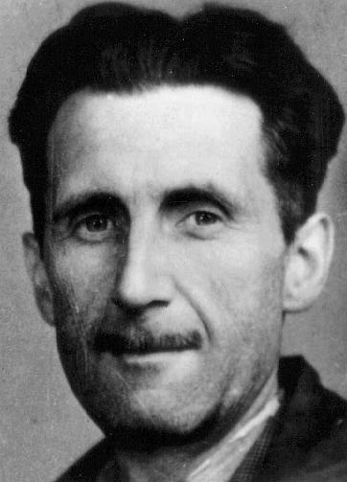
George Orwell, 1903-1950
World War II
Insecurity
Atomic bomb
Annihilation
Stability = continued warfare
1984, 1949
Animal Farm 1945

Slide 4
Summary
3 super-states:
Oceania = America + Britain
Eurasia = Russia + Europe
Eastasia = China + the Asiatic countries
London - Airstrip One
4 ministries: Truth, Love, Peace, Plenty

Slide 5
Summary II
Thought Police
Contradictions
Big Brother
The Proles = 85 %
Conditions were bad
No laws
Social activities
No privacy
Sex for procreation – soldiers for the State

Slide 6
Summary III
Language – vocabulary
Good – plusgood – doubleplusgood / ungood etc.
The Past – infallibility
Power for Power’s sake
Fear is the ruler
Violence and Torture
The Brotherhood?
Winston and Julia

Slide 7
George Orwell, 1984
http://video.google.com/videoplay?docid=-5464625623984168940#
Equilibrium
http://www.youtube.com/watch?v=4dH5UAv-JiM

Slide 8
Questions
Correlations between our society today and that depicted in 1984 and Equilibrium?
The role of the media (propaganda?)
War – (9/11, Iraq, Afghanistan)?
Power
Corruption (politicians?)
Individual identity
Classes and privileges
Love and Sexuality

