Slide 1
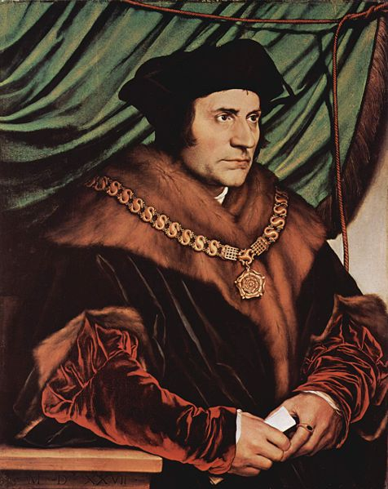
Utopias, Dystopias and Science Fiction
Sir Thomas More

Slide 2
Utopia Eutopia
“No Place”
Model of the good society
Unrealistic daydream
“The Good Place”
Ambiguity of terms
Dream place

Slide 3
Utopias
Typically a visitor arrives
Geographical isolation
Temporal isolation
Wish to appear realistic and realizable
Problem today: the world has shrunk

Slide 4
Utopian or Dystopian Satire
Ridicule
No solution
Sir Thomas More, 1478-1535

Slide 5
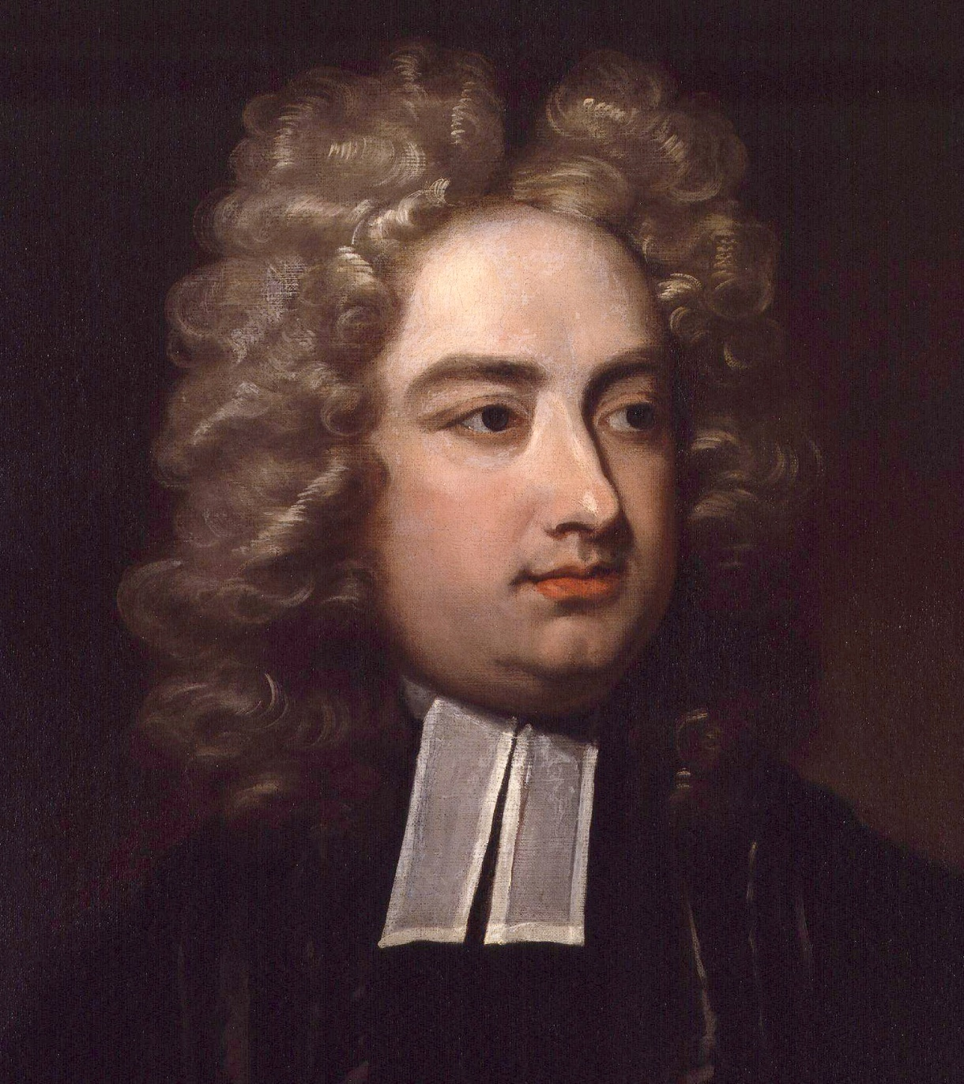
Satire
Gulliver’s Travels
Erewhon
Jonathan Swift, 1667-1745

Slide 6
Aspects of Utopias
Socialism
Democracy – dictatorship?
Religion
War – power
Technology
Work – leisure

Slide 7
Works
Thomas More – Utopia, 1516
Francis Bacon – New Atlantis, 1605
Jonathan Swift – Gulliver’s Travels, 1726
Mary Shelley – Frankenstein, 1818
Samuel Butler – Erewhon, 1872
William Morris – News from Nowhere, 1890
H.G.Wells – The Time Machine, 1895
The War of the Worlds, 1898

Slide 8
Utopia, Thomas More
What are the main criticisms of the existing British society?
Courtiers
The justice system and punishment in England
The noblemen and their exploitation
The Enclosure movement
The King and his ambitions
Avarice and Greed

Slide 9
Questions Utopia, Thomas More
1) Give a brief outline of the basic characteristics of Utopia
2) What is the role of men, women, and children?
3) Which of these characteristics appeal to you and which do not? Why / why not?

